Slide 1

EyeCloud
Introducing & Traceability for Turkey
March 2021
© ESSILOR – Group IT Solutions / Digital Innovation – For internal use only. Do not disclose or copy.

Slide 2




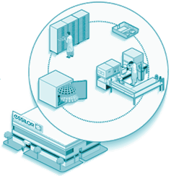
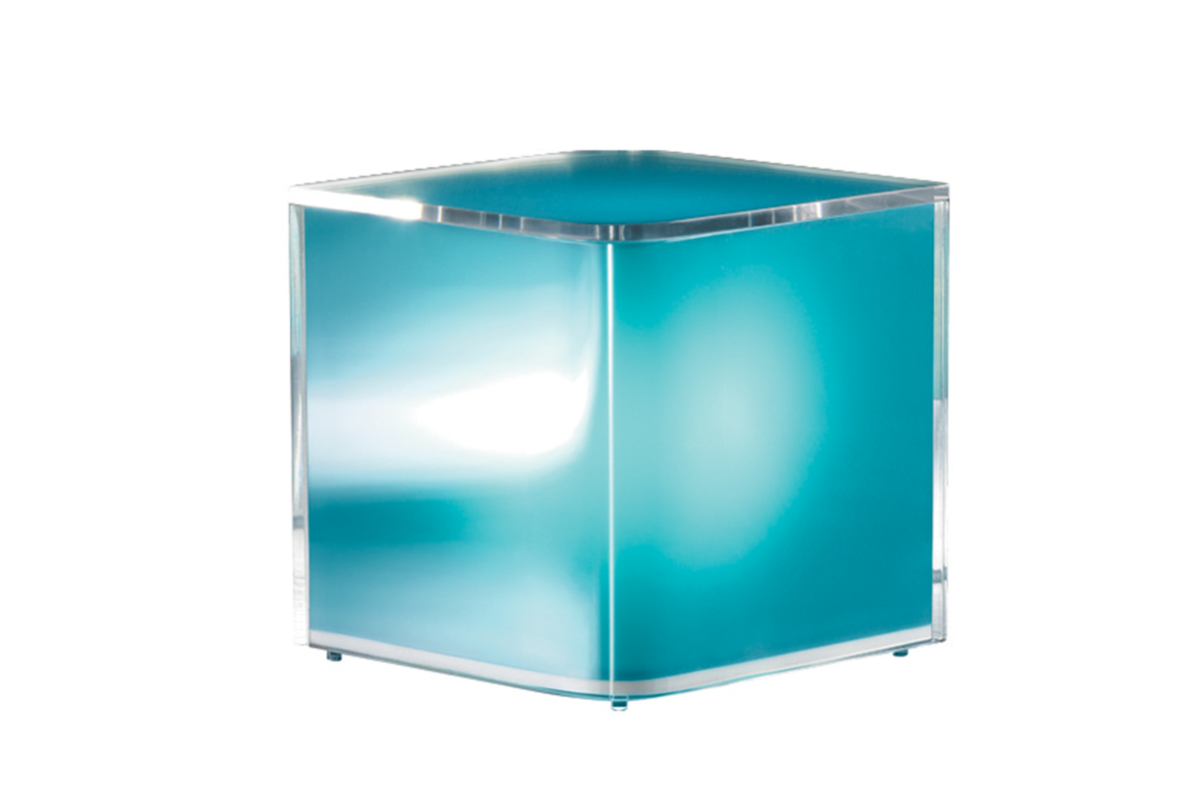





What is EyeCloud
"EyeCloud is a database enabling all actors involved in the ordering and manufacturing process of lenses to find and share the data they need (about lenses, frames)."
EyeCloud benefits:
Provides unique ID
Can store any kind of info (files any format or metadata) in a centralized storage in the cloud.
Secure the storage
^{Platform of services above EC}

Slide 3
EyeCloud service level agreement
Business Expectations
Services Capabilities
24/7 business with on-duty support
24/7 Support & monitoring
No disruption during hours of operations
99.9% Unplanned Downtime by 2019
All P1 addressed in 1H & resolved* in 4H.
Storage of data for 3y (hot storage) + 2y (cold storage)
Storage of data for 3y (hot storage) + 2y (cold storage)

Slide 4

High level flow for traceability for IT Europe systems
Opsys Web
(web ordering system)
Orchestra
(Ordering management system)
LSM Inlab
1
ECID A
ECID A
Picking
Traceability file (many info) POST on ECID A
Formater
GS1-->Traceability format
2
Business Sub Web portal
EyeCloud
“GET traceability for ECID A”
3
Datalake
Massive queries
Internal Quality
Traceability info
Traceability info
Traceability info

Slide 5
High level flow for traceability for IT Europe systems
Opsys Web
(web ordering system)
Orchestra
(Ordering management system)
LSM Inlab
1
ECID A
ECID A
Picking
Traceability file (many info) POST on ECID A
Formater
GS1-->Traceability format
2
Business Sub Web portal
EyeCloud
“GET traceability for ECID A”
1
3
The ECP makes an order to Essilor.
On the back end: the web ordering system asks for Eyecloud to have an Unique Order ID (UOID). It can possibly store documents or data into EyeCloud if he needs to. But in this use case, no need. The ordering system transfers the UOID to the next system of the ordering flow.
Datalake
Massive queries
Internal Quality
Traceability info
Traceability info
Traceability info

Slide 6
High level flow for traceability for IT Europe systems
Opsys Web
(web ordering system)
Orchestra
(Ordering management system)
LSM Inlab
1
ECID A
ECID A
Picking
Traceability file (many info) POST on ECID A
Formater
GS1-->Traceability format
2
Business Sub Web portal
EyeCloud
“GET traceability for ECID A”
2
3
if Orchestra wants/needs, Orchestra can store data/file linked to the previous order into the same storage container (thanks to the UOID).
In the traceability use case, no need.
Orchestra just sents the UOID to the next system (inlab).
Datalake
Massive queries
Internal Quality
Traceability info
Traceability info
Traceability info

Slide 7
High level flow for traceability for IT Europe systems
Opsys Web
(web ordering system)
Orchestra
(Ordering management system)
LSM Inlab
1
ECID A
ECID A
Picking
Traceability file (many info) POST on ECID A
Formater
GS1-->Traceability format
2
Business Sub Web portal
EyeCloud
“GET traceability for ECID A”
3
3
The LMS (Inlab) picks up the semi finished lenses from the local stock. During this picking phase reads the datamatrix and create the traceability file.
Thanks to the previous UOID, inlab stores the traceability file into EyeCloud in the storage space dedicated to the previous order.
Datalake
Massive queries
Internal Quality
Traceability info
Traceability info
Traceability info

Slide 8

High level flow for traceability for IT Europe systems
Opsys Web
(web ordering system)
Orchestra
(Ordering management system)
LSM Inlab
1
ECID A
ECID A
Picking
Traceability file (many info) POST on ECID A
Formater
GS1-->Traceability format
2
Business Sub Web portal
EyeCloud
“GET traceability for ECID A”
3
EyeCloud sends the traceability files of any orders to a datalake which would be used to make massive requests (sample: “find me all the lot number = XXXX from start_date to end_date”).
4
Datalake
Massive queries
Internal Quality
Traceability info
Traceability info
Not in place yet
Traceability info

Slide 9
High level flow for traceability for IT Europe systems
Opsys Web
(web ordering system)
Orchestra
(Ordering management system)
LSM Inlab
1
ECID A
ECID A
Picking
Traceability file (many info) POST on ECID A
Formater
GS1-->Traceability format
2
Business Sub Web portal
EyeCloud
“GET traceability for ECID A”
5
3
In case of punctual request for a specific order, the B2B web portal of a sub can make a request to EyeCloud to retrieve the traceability file for the concerned order.
Datalake
Massive queries
Internal Quality
Traceability info
Traceability info
Traceability info

